Slide 1


Top Discriminator Signal Over Bkg for several selection Categories NTUA
Giannis Papakrivopoulos
George Bakas

Slide 2
Signal Over Bkg
Signal over Background for
Mtt samples over Bkg
Nominal sample over Bkg
Categories:
1. Both jets are top tagged and b tagged
2. 1 Jet top and b tagged and other jet top tagged
3. 1 Jet top and b tagged and other jet b tagged
4. Both jets are top tagged
5. Both jets are b tagged
Cuts: nJets > 1, |jetEta| < 2.4 (bot jets), jetPt > 400 GeV (both jets)
mTTbarParton > 1000 GeV
Top Tagger selection cuts: 120 GeV < jetMassSoftDrop < 200 GeV (both jets)

Slide 3
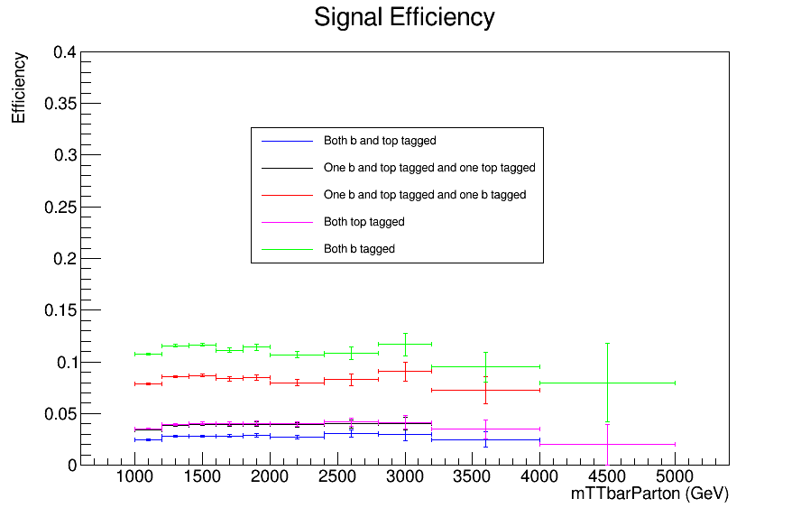
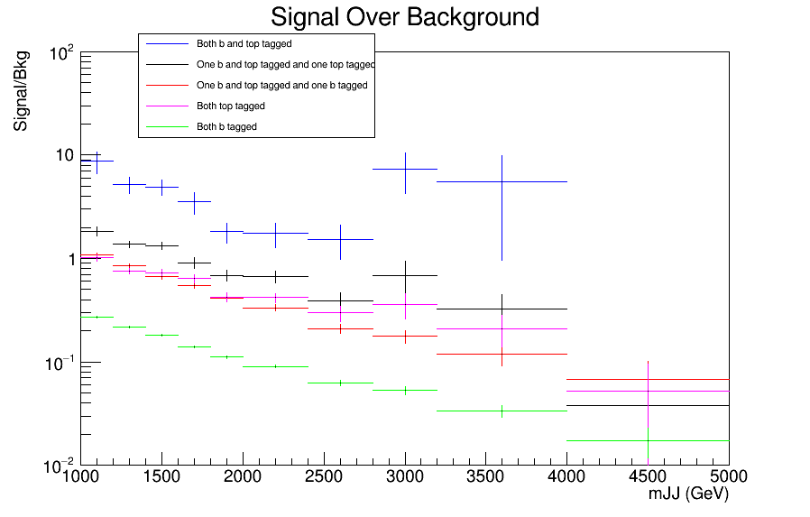
Signal over Bkg for mJJ (reco)
Top tagger cut : 0.6
B-tagging: loose working point
nominal TT_TuneCUETP8M2T4_13TeV-powherg-pythia8
Over Bkg (All Categories)

Slide 4
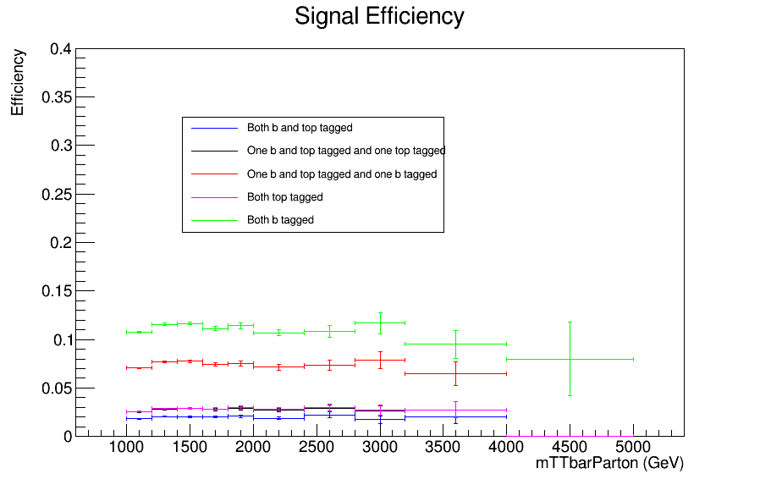
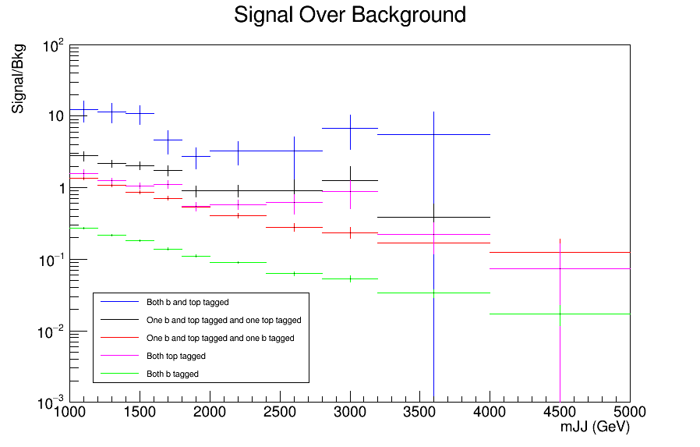
Signal over Bkg for mJJ (reco)
Top tagger cut : 0.7
B-tagging: loose working point
nominal TT_TuneCUETP8M2T4_13TeV-powherg-pythia8
Over Bkg (All Categories)

Slide 5
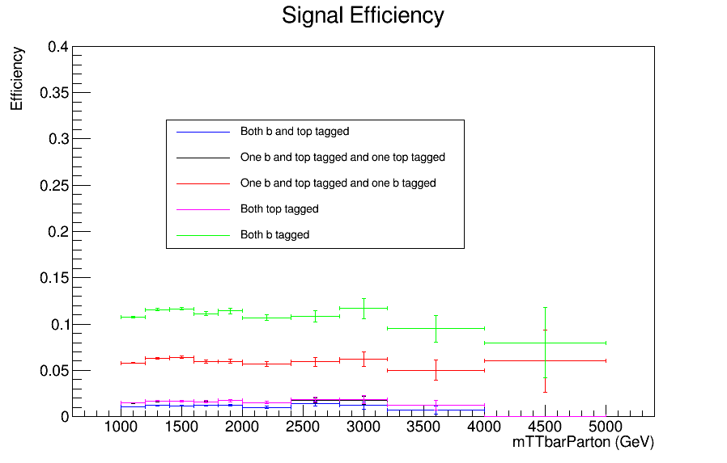
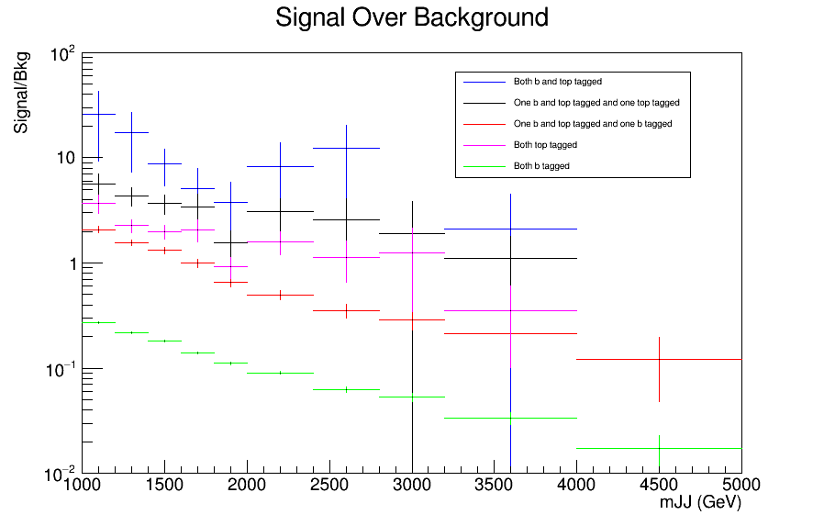
Signal over Bkg for mJJ (reco)
Top tagger cut : 0.8
B-tagging: loose working point
nominal TT_TuneCUETP8M2T4_13TeV-powherg-pythia8
Over Bkg (All Categories)

Slide 6
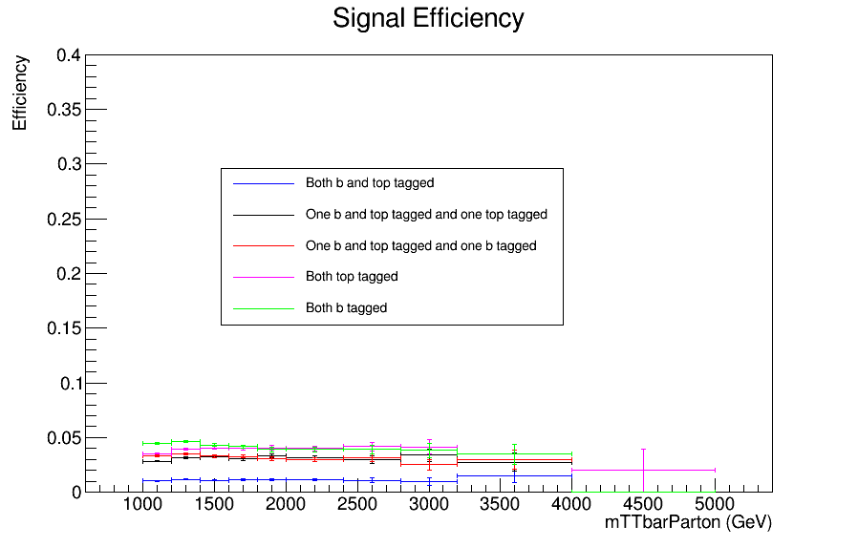
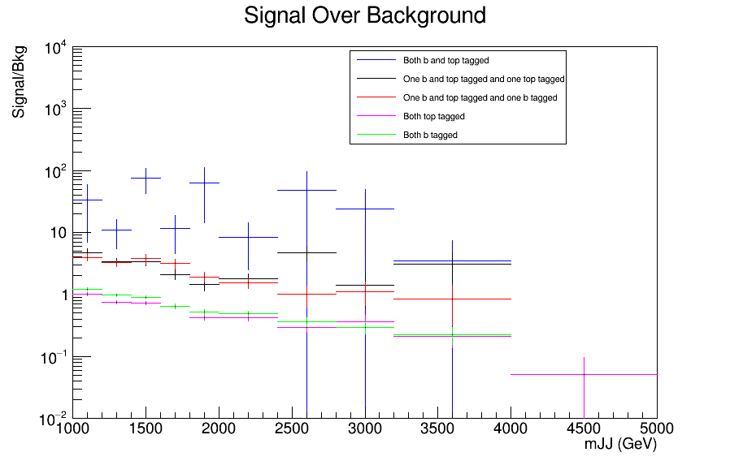
Signal over Bkg for mJJ (reco)
Top tagger cut : 0.6
B-tagging: Medium working point
nominal TT_TuneCUETP8M2T4_13TeV-powherg-pythia8
Over Bkg (All Categories)

Slide 7
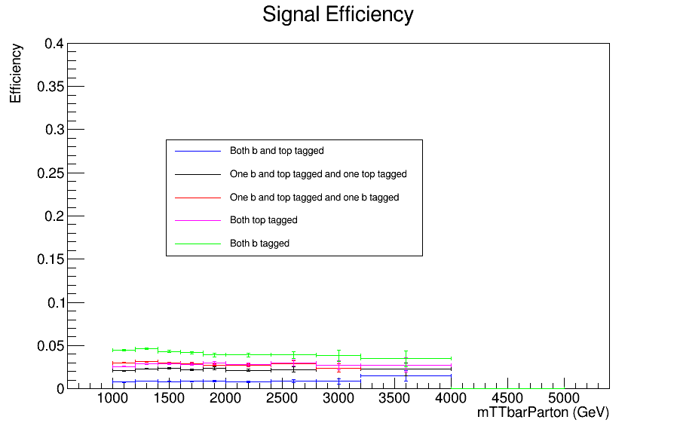
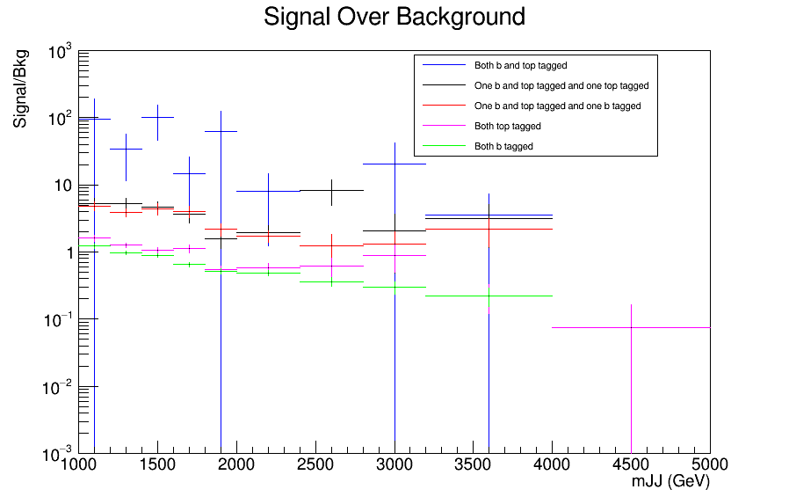
Signal over Bkg for mJJ (reco)
Top tagger cut : 0.7
B-tagging: Medium working point
nominal TT_TuneCUETP8M2T4_13TeV-powherg-pythia8
Over Bkg (All Categories)

Slide 8
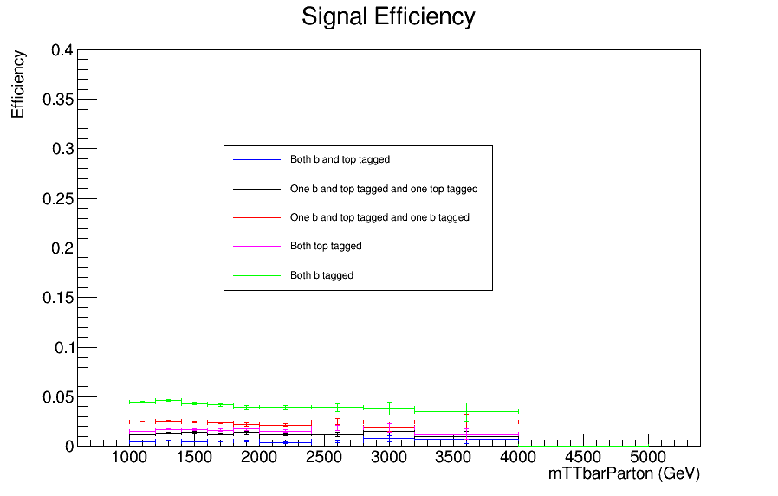
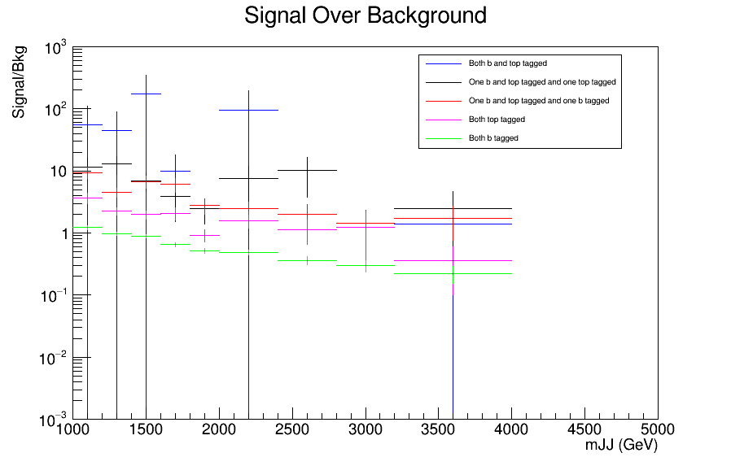
Signal over Bkg for mJJ (reco)
Top tagger cut : 0.8
B-tagging: Medium working point
nominal TT_TuneCUETP8M2T4_13TeV-powherg-pythia8
Over Bkg (All Categories)

Slide 9
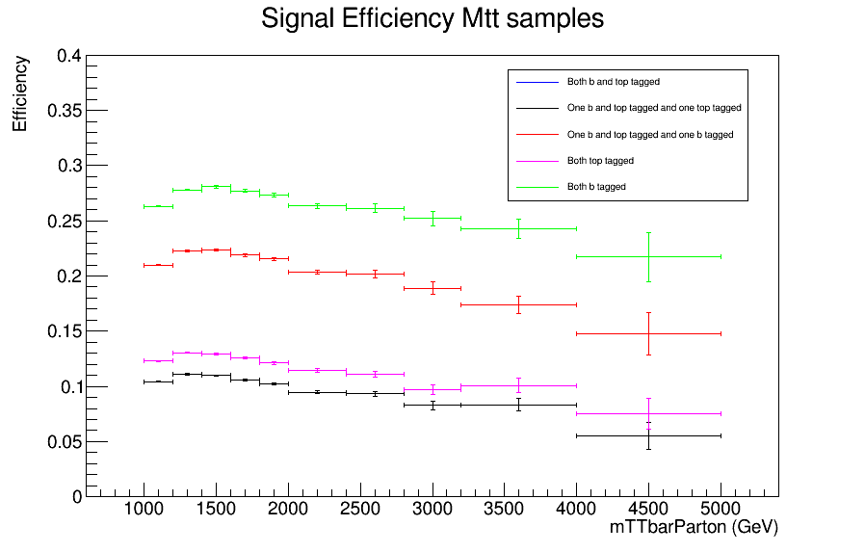
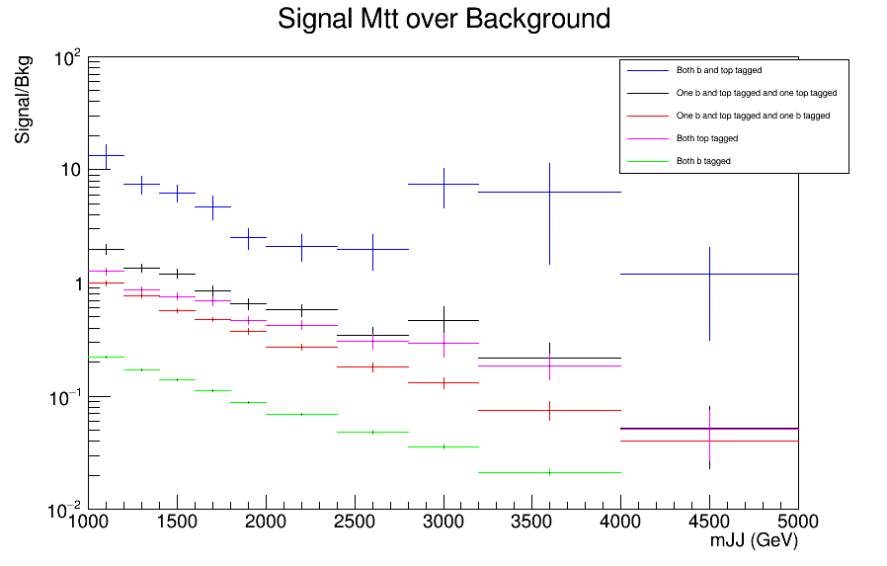
Signal over Bkg for mJJ (reco)
Top tagger cut : 0.6
B-tagging: loose working point
Mtt Samples

Slide 10
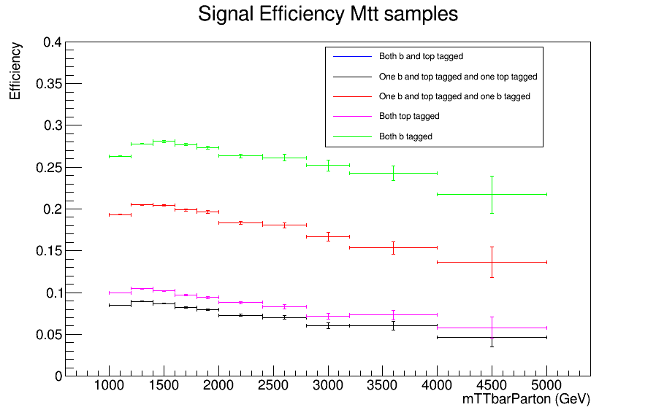
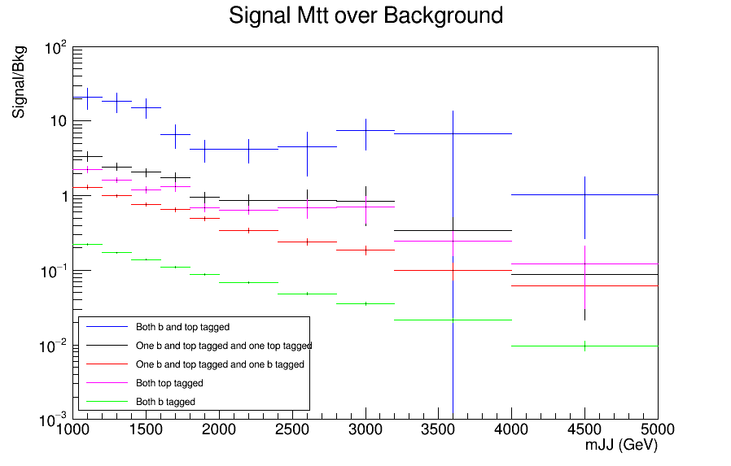
Signal over Bkg for mJJ (reco)
Top tagger cut : 0.7
B-tagging: loose working point
Mtt Samples

Slide 11
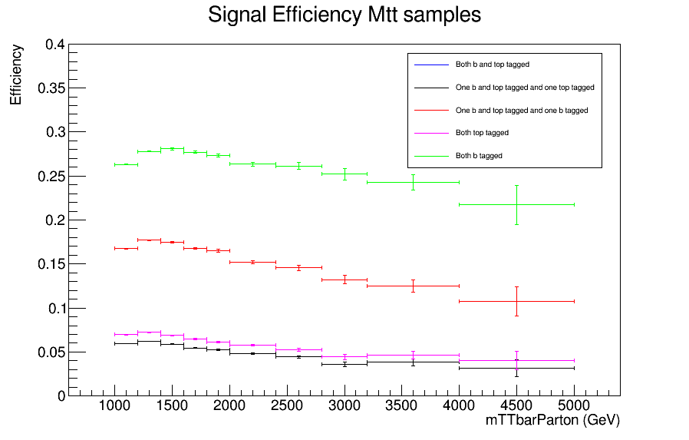
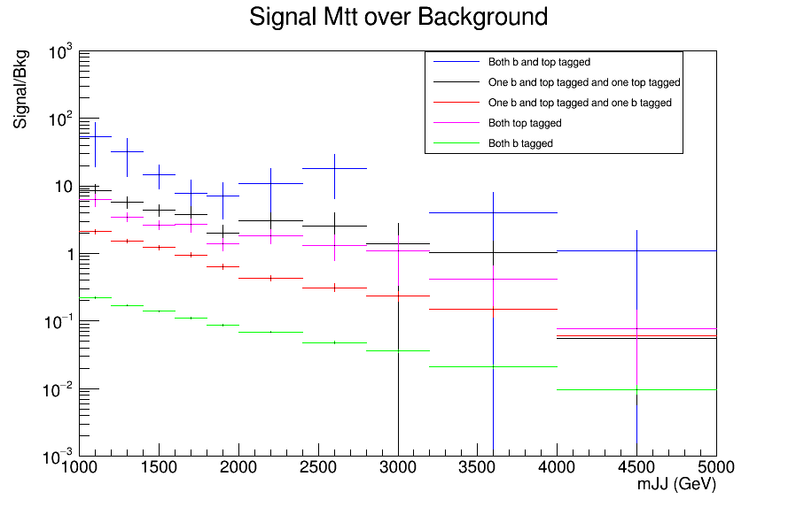
Signal over Bkg for mJJ (reco)
Top tagger cut : 0.8
B-tagging: loose working point
Mtt Samples

Slide 12
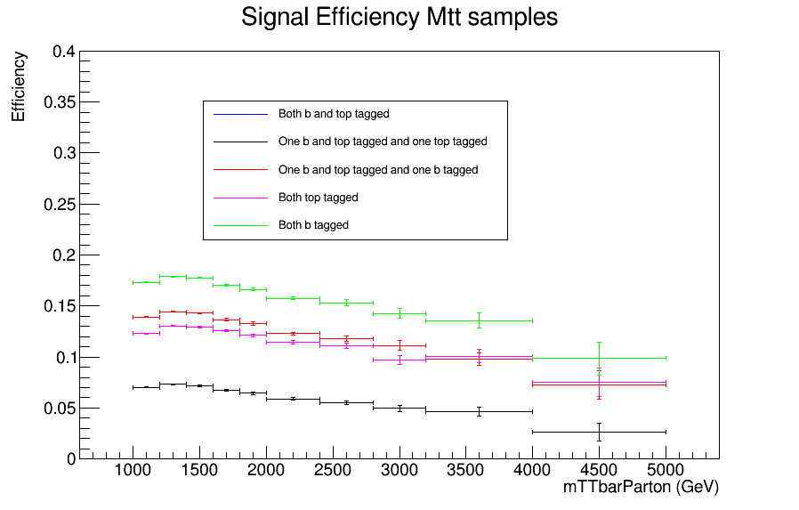
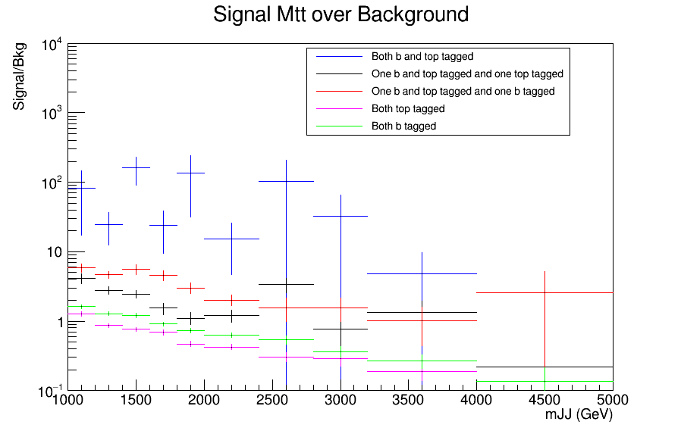
Signal over Bkg for mJJ (reco)
Top tagger cut : 0.6
B-tagging: Medium working point
Mtt Samples

Slide 13
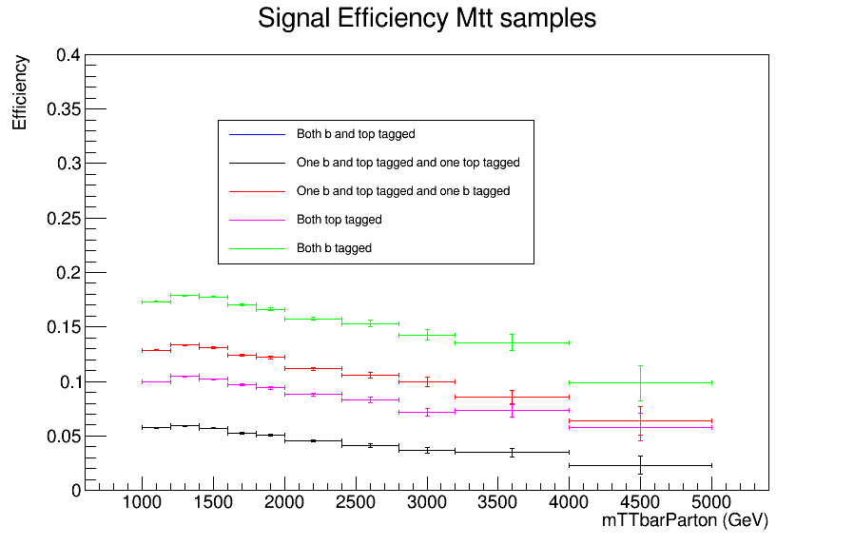
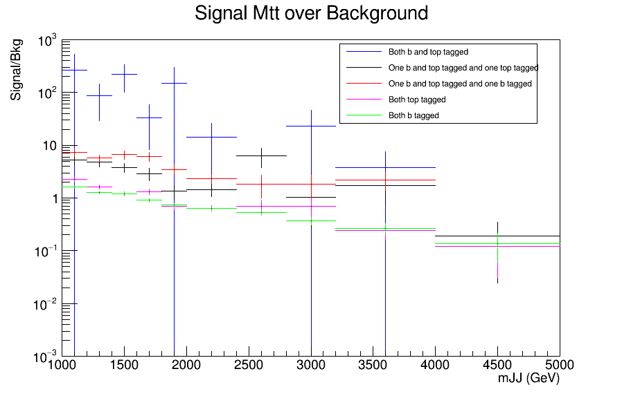
Signal over Bkg for mJJ (reco)
Top tagger cut : 0.7
B-tagging: Medium working point
Mtt Samples

Slide 14
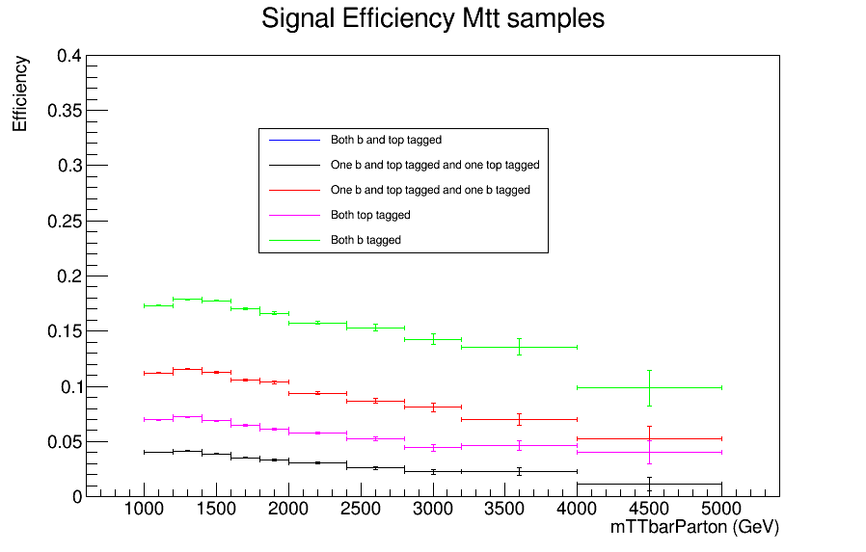
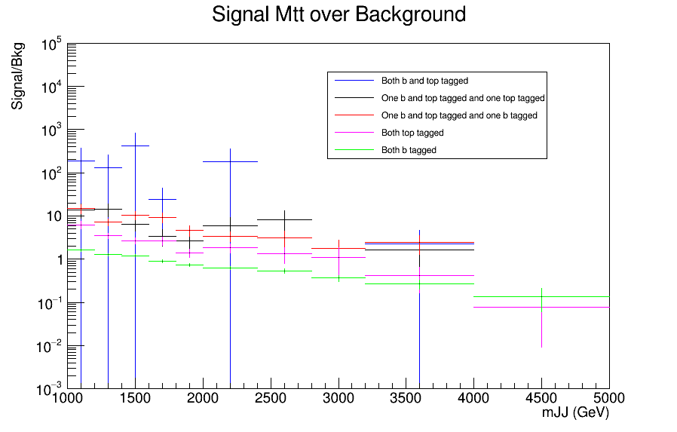
Signal over Bkg for mJJ (reco)
Top tagger cut : 0.8
B-tagging: Medium working point
Mtt Samples

Slide 15
 | Slope Signal | Slope MTt | Events Signal bin 9 | Events signal bin 10 | Events signal total | Events Mtt bin 9 | Events Mtt bin 10 | Events Mtt total | Events bkg bin 9 | Evetns bkg bin 10 | Events bkg total
0.6, 0.5803, 1 | -5.12E-08 | -1.41E-05 | 4.22942 | 0 | 7084 | 4.57866 | 0.460289 | 160479 | 0.773183 | 0.448648 | 319
0.7, 0.5803, 1 | -1.02E-06 | -1.61E-05 | 3.07594 | 0 | 5170 | 3.31892 | 0.387611 | 128602 | 0.548859 | 0.448648 | 136
0.8, 0.5803, 1 | -9.96E-07 | -1.38E-05 | 1.15348 | 0 | 3046 | 2.10764 | 0.266483 | 88720 | 0.548859 | 0.224324 | 44
0.6, 0.8838, 1 | -6.63E-07 | -1.22E-05 | 1.92246 | 0 | 2932 | 2.5437 | 0.218031 | 105961 | 0.548859 | 0 | 33
0.7, 0.8838, 1 | -3.41E-07 | -1.38E-05 | 1.92246 | 0 | 2185 | 1.91383 | 0.193806 | 85374 | 0.548859 | 0 | 19
0.8, 0.8838, 1 | -5.74E-07 | -1.11E-05 | 0.768985 | 0 | 1305 | 1.25974 | 0.0969029 | 59351 | 0.548859 | 0 | 9
0.6, 0.5803, 2 | 2.67E-07 | -1.41E-05 | 6.15188 | 0.384492 | 9868 | 4.57866 | 0.460289 | 160479 | 22.6823 | 10.1694 | 1479
0.7, 0.5803, 2 | -4.49E-07 | -1.61E-05 | 4.22942 | 0.384492 | 7149 | 3.31892 | 0.387611 | 128602 | 11.0667 | 5.19687 | 673
0.8, 0.5803, 2 | -6.95E-07 | -1.38E-05 | 2.30695 | 0 | 4163 | 2.10764 | 0.266483 | 88720 | 2.09523 | 4.42368 | 198
0.6, 0.8838, 2 | -5.12E-07 | -1.22E-05 | 5.38289 | 0 | 8066 | 2.5437 | 0.218031 | 105961 | 1.99501 | 0.773183 | 534
0.7, 0.8838, 2 | -1.19E-06 | -1.38E-05 | 3.84492 | 0 | 5874 | 1.91383 | 0.193806 | 85374 | 1.22183 | 0.773183 | 274
0.8, 0.8838, 2 | -1.29E-06 | -1.11E-05 | 1.92246 | 0 | 3444 | 1.25974 | 0.0969029 | 59351 | 0.773183 | 0 | 78
0.6, 0.5803, 3 | -3.62E-06 | -1.85E-05 | 17.6866 | 1.53797 | 21912 | 9.54493 | 1.23551 | 325514 | 166.9 | 33.8881 | 7230
0.7, 0.5803, 3 | -3.67E-06 | -1.74E-05 | 16.5332 | 1.53797 | 19635 | 8.43055 | 1.13861 | 298670 | 110.253 | 18.7072 | 4940
0.8, 0.5803, 3 | -5.27E-06 | -2.49E-05 | 11.5348 | 1.53797 | 16110 | 6.8801 | 0.896352 | 256672 | 57.2809 | 15.8149 | 2832
0.6, 0.8838, 3 | -4.95E-06 | -1.84E-05 | 5.76738 | 0 | 8889 | 5.37811 | 0.605643 | 210843 | 6.76713 | 0.224324 | 622
0.7, 0.8838, 3 | -4.19E-06 | -1.79E-05 | 5.76738 | 0 | 8002 | 4.69979 | 0.532966 | 194168 | 2.66799 | 0 | 458
0.8, 0.8838, 3 | -3.70E-06 | -2.21E-05 | 3.46043 | 0 | 6601 | 3.85189 | 0.436063 | 167722 | 1.99501 | 0 | 279

Slide 16
Questions
Comments:
Overlapping categories 1 and 2 in Mtt sample. We tried different ways to identify why this could be happening. But it looks like that in this sample, whenever you have an event with a top and b tagged jet and a second jet that is top tagged, the second jet is always b tagged also.
Could you propose a way that we can identify why this is happening and if it is normal?
Difference in efficiencies between Mtt and Signal. We are thinking that we are not Scaling the nominal signal correctly. We use 832 pb as the Cross section value but we are only using one of the samples (75e^+6). Could this be the problem? Although we do not think so because the nominal has a single slice and the scaling factors cancel out when computing the efficiency.
We also tried to identify the working point with the best performance. Stability, by identifying the slope of a linear fit. Number of events in the final two bins (after 3.5 TeV) .

